Slide 1
YogNatomy
An Introductory Presentation
By:
Cade W. Dillon
30 September 2018

Slide 2
Agenda
So, what is YogNatomy?
Objectives of YogNatomy
How does YogNatomy interact with the user?
Use Cases
Use Case Diagram
User Interface Mock Ups
Entity Relationship Diagram
Database Design
Software Requirements
Planned Features
In Summary
Questions?

Slide 3
So, what is YogNatomy?
First and foremost, YogNatomy is a tool to aid the user in performing maintenance on their bodies.
We all can become rundown after periods of intense physical activity, injury, or as a result of the aging process.
If we don’t maintain our bodies correctly, they can fall into a state of disrepair.
Yoga is a form of exercise that has been used for thousands of years to correct muscular imbalances, postural deficiencies, and aid in recovery.
Ultimately, YogNatomy brings the knowledge and power to maintain and potentially rehabilitate muscular integrity and health to anyone with a smartphone and a mat!

Slide 4
Objectives of YogNatomy
The highest objective of YogNatomy is ease of use.
You shouldn’t need to have spent a semester in Pre-Med to understand the layout and design.
The primary demographic will be athletically conditioned adults, but the elderly and people with disabilities will also be a large demographic.
The next objective is to make it all interweave in a way that feels intuitive.
The poses themselves will be separated into categories, and so will the major muscle groups of the body.
In the final version of the app, you should be able to traverse the body up and down in a chain fashion, seeing which poses would be effective for that group.
The reverse will also be true, you will be able to search a pose and have it return information, a picture for illustration, and Wikia style links to related poses and the muscle groups that pose targets.

Slide 5
User Stories
“As a recreational athlete, I want a convenient tool I can use to manage my recovery, so that I can become the strongest version of myself.”
“As a professional trainer, I need a platform to be able to assign exercises to my clients, so that they will be better prepared for our in-person sessions.”
As a database administrator for YogNatomy, I need a clean and reliable interface for which to manage user and exercise information, so that we can continue to grow YogNatomy!”

Slide 6
Trainee Use Case
Trainee wants to search an exercise that will help with a pulled hamstring.
Trainee launches and logs into YogNatomy (on first use trainee would register account)
Under drop down menu, trainee selects Leg muscle group
Trainee navigates to hamstring subset, and selects an exercise that looks appealing.
Alternatively, the user could navigate to the dynamic diagram, or use the search bar feature for the same result.
Trainee performs exercise! Success!

Slide 7
Trainer Use Case
Trainer wants to assign an exercise that will help a client rehabilitate a strained rotator cuff.
Trainer logs into Yognatomy.
Trainer selects Client view from page header, which returns a new view that has a list of all the clients belonging to the Trainer.
Trainer hovers over client, and selects the ‘Assign’ function (button).
This redirects to the search feature, the Trainer enters “Shoulders”
The shoulder muscle group search is returned, the trainer selects the exercise to the client, who receives notification upon their next login.

Slide 8

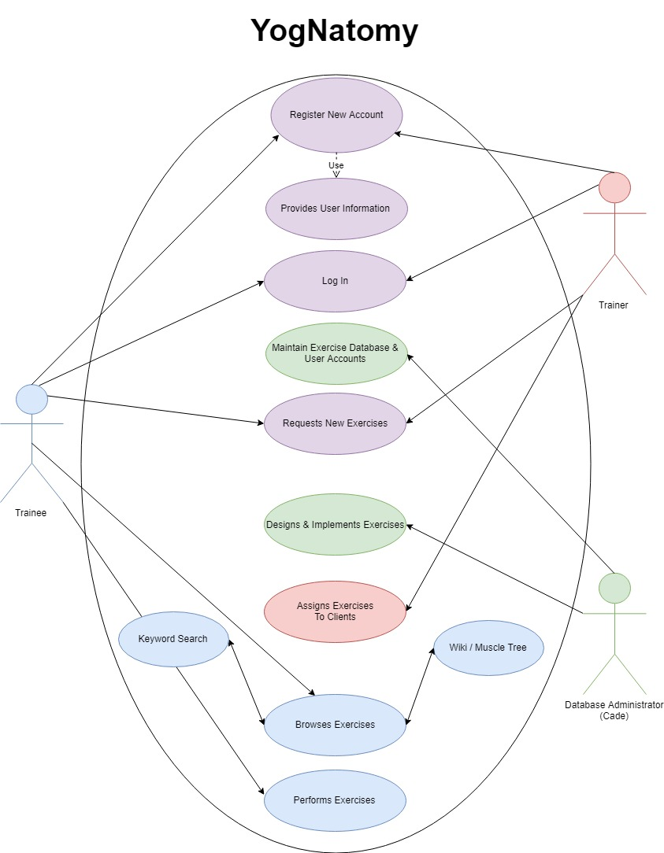
Use Case Diagram

Slide 9
How Does Yognatomy Interact With the User?
The very first screen that the user will interact with will be nearly blank, save for the logo and a box which asks, “What hurts today?”
The user selects a muscle group from a wheel selector (I don’t know what they’re formally called, you know the one) and that brings them to a list of effective poses.
Users are then free to traverse the wikia style pages, the muscle chains, or use a search function to find what they’re looking for on their own.
In the base version, all the app outputs to the user is information.

Slide 10
What are the inputs and outputs?
I envision that the framework of the application will be located on the user’s device, however, the user will send and receive data over the network.
Essentially, when the user launches the application, it performs a data sync with the host server and loads in all of their stored information, workouts, and any current update/patches.
This way, the app is a living entity and I can choose to make changes and address them as I identify them.
I think that this puts the app into a category of “Web app.”
I’ll find more examples of other web apps and try to model my app after the things I like about them.

Slide 11
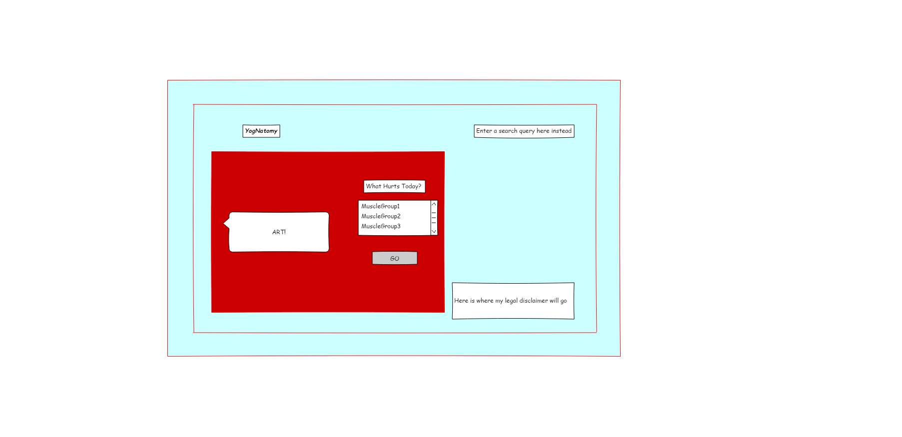
GUI Sketch V1

Slide 12

GUI Landing Page V2

Slide 13
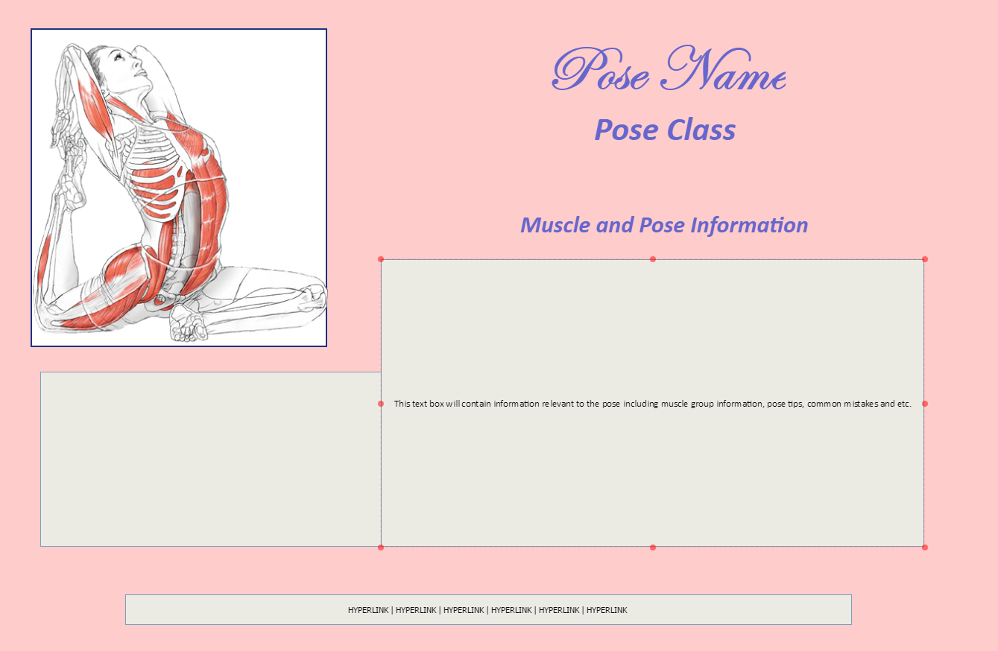
Pose Information Page

Slide 14
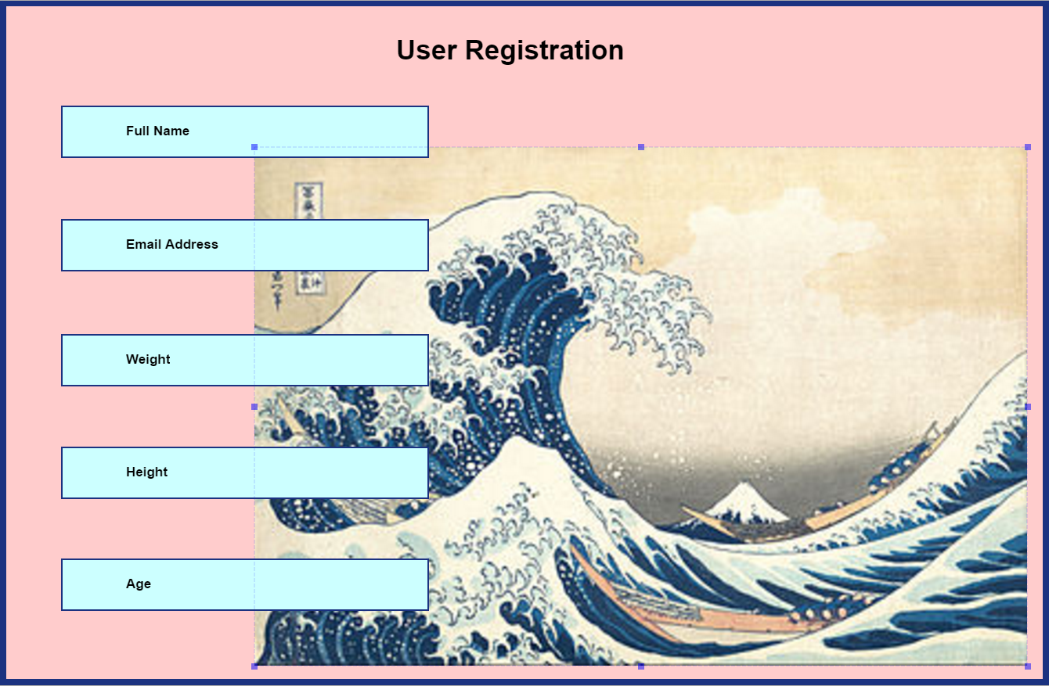
User Registration Interface

Slide 15
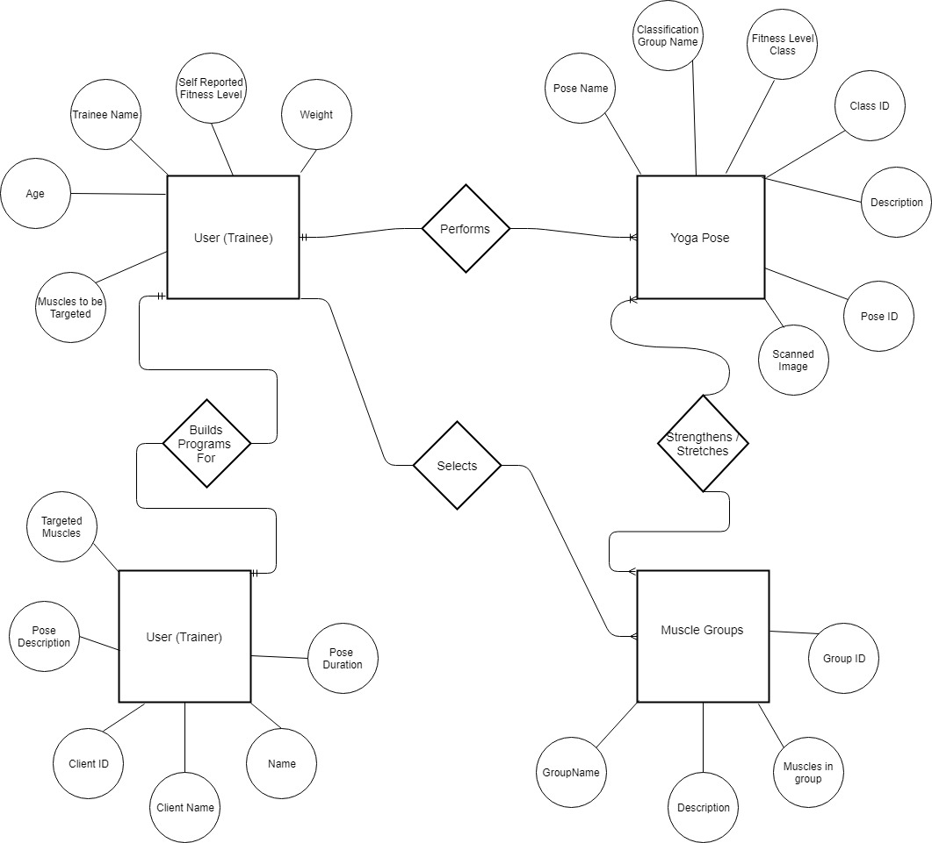
Entity Relationship Diagram (ERD)

Slide 16
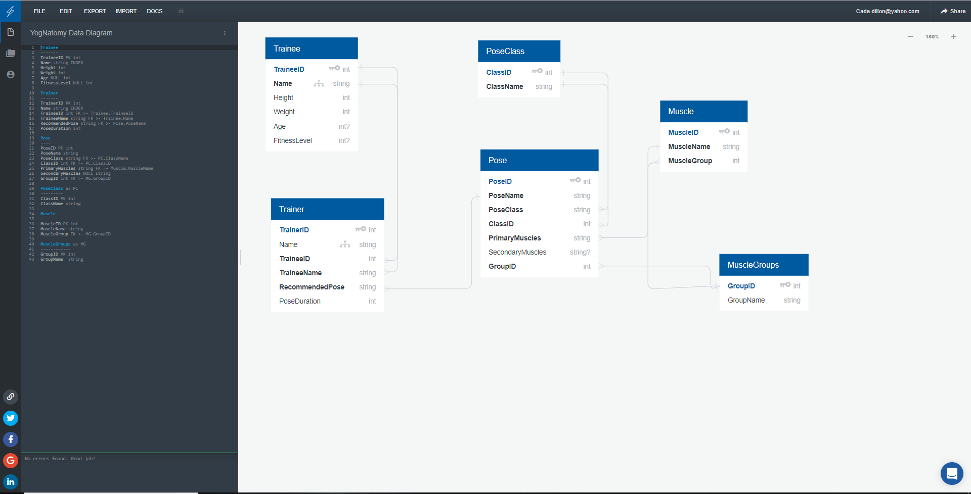
Database Design

Slide 17
Software Requirements
All users must be able to intuitively navigate wikia style pages, muscle anatomy diagram, and built in search functions.
Trainer users must be able to assign poses to clients, request new poses from the DBA, and browse existing poses.
Trainee users must be able receive assignments, register new accounts, log in to existing accounts, manage trainer relationships, and view exercise completion history.
Database administrators must be able to manage user accounts and maintain/update pose database to allow for expansion of the application.
The project must be scalable and dynamic.
A clean user interface is high in the list of priorities.

Slide 18
Test Cases
I want to beta test the finished application in the classroom!
We could assign Trainees and Trainers, and test against the Software requirements!
I will, of course, be the Database administrator.

Slide 19
Planned Features
Eventually I would like YogNatomy to support a few features I’m not sure will be feasible for the “launch version.”
The major feature is an application generated workout based on User input. It could take variables like age, fitness level, goals, etc. and generate a (relatively) comprehensive individualized workout routine.
Also, the “launch version” will probably have a limited database of poses, and eventually expanding would be a good thing.
Monetization?

Slide 20
In Summary
In summary, YogNatomy is going to take the fitness app world by storm and generate millions of dollars while also helping people get and stay healthy.
The more I think about it, the more I suspect that I’m treading in some kind of legal grey area where it may be against the law to offer too much advice/guidance to people with any kind of pre-existing injuries/disabilities.
Also, I’m taking the entire database images and all out of a copyrighted book so I’ll need to address that if I actually want to build this bigger than a school project.

Slide 21
Questions?

